Slide 1

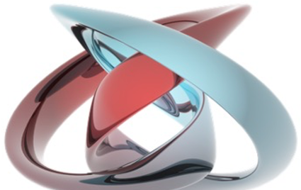
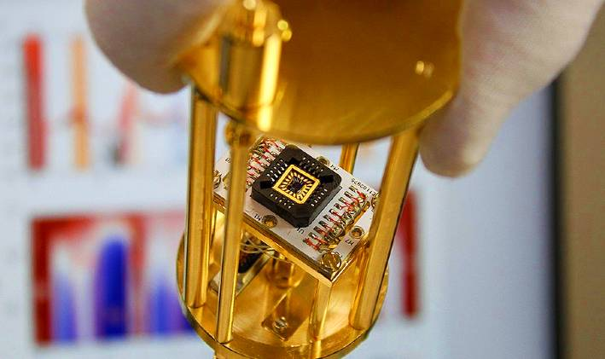
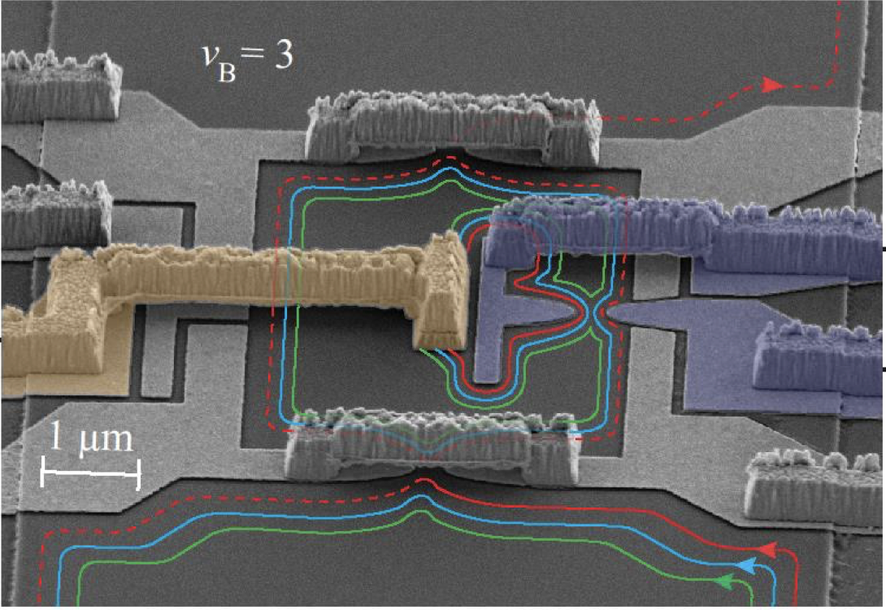
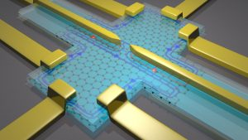
Laboratory of Quantum Physics: Topology and Correlations
Quantum transport in Mesoscopic systems
(PHYS-462)

Slide 2
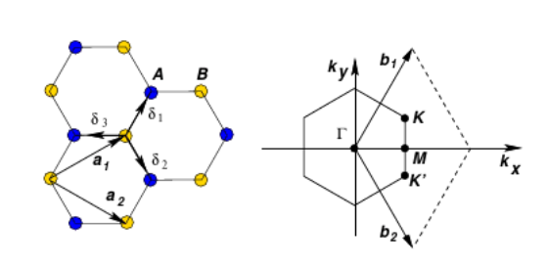
TB model nearest neighbor hopping
Graphene is a two-dimensional single-layer carbon atom crystal. It forms sp₂ hybridization from carbon atoms 2s and 2p_{x} and 2p_{y} orbitals.
Each carbon atom forms three covalent bonds with its three nearest neighbors with equally angle 2π/3, and the remaining 2p_{z} electrons form a π-bond that changes vertically he plane

Slide 3
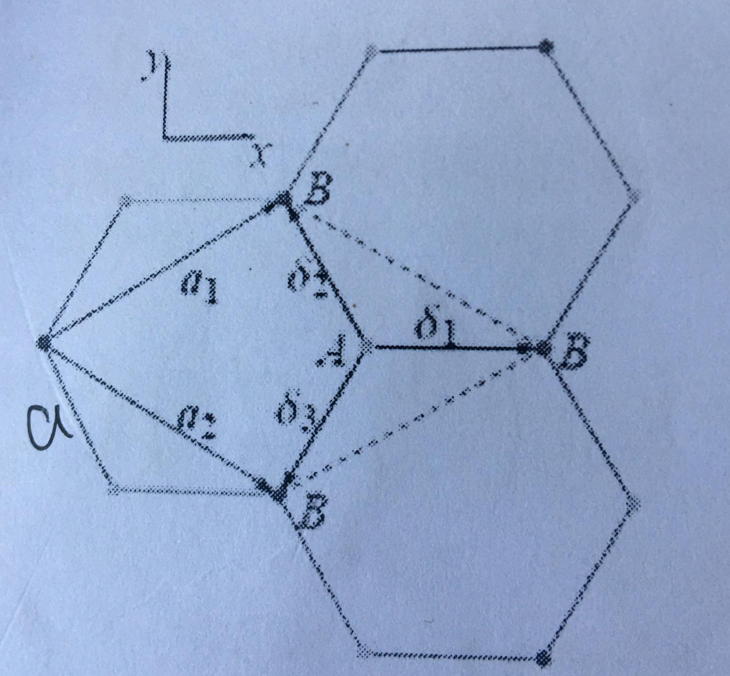
Graphene
Graphene(monolayer,Hexagonal lattice structure)
The lattice vector and reciprocal lattice vector:

Slide 4
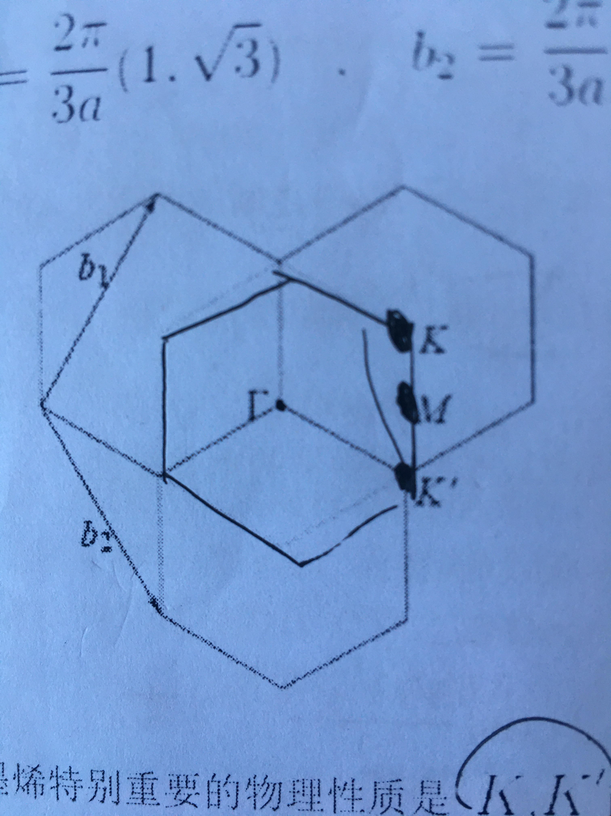
Graphene
The first brillouin zone in graphene，K(K’), M, Γ are high symmetry points:
The three nearest neighbors in real space,By using the tight bound approximation and considering only the nearest neighbor atom interaction, the electron can jump to the nearest neighbor atom (nearest neighbors hopping).

Slide 5
Graphene
The nearest neighbor vector in real space:
One primitive cell of graphene contains two non-equivalent carbon atoms, whose 2P_{Z} orbital wave function is respectively
R_{l} is the lattice vector of the Lth lattice point, l₁ and l₂ is the position vector of the first and second atom of the Lth protocell

Slide 6
Graphene
According to atomic orbital linear grouping，The wave function of the system and the corresponding SE is

Slide 7
Graphene

Slide 8
Graphene
t is the transition energy between the nearest neighbor atoms

Slide 9
Graphene
Similarly, using taking inner product with <ϕ₂|

Slide 10
Graphene
So, for the homogeneous linear system of c₁ and c₂, there are sufficient and necessary conditions for non-zero solutions,the secular equation is obtained：

Slide 11
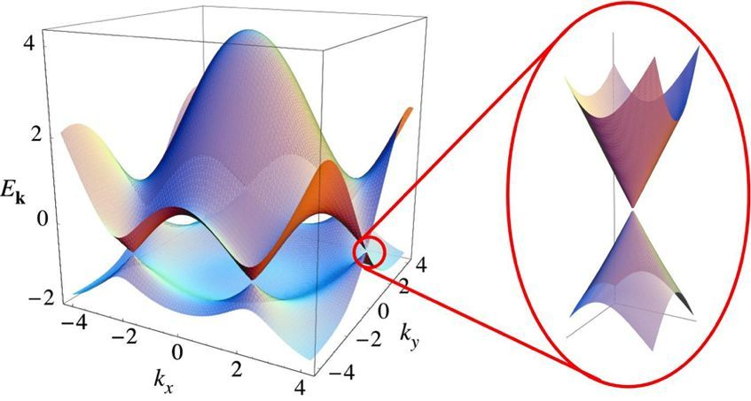
Graphene
ε_{pz}is the potential energy, zero for the ideal structure graphene, so the electron dispersion relation：
The Hamiltonian of system then is:

Slide 12
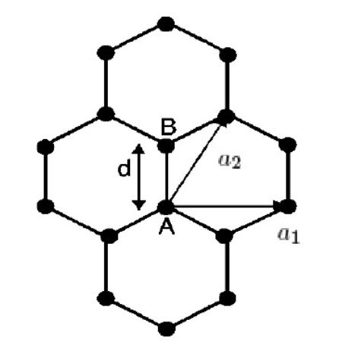
Graphene
The six vertices in the first Brillouin region are the Dirac Points.

Slide 13
Graphene
Put at a₁ and a₂ in above:

Slide 14
Graphene
Put at a₁ and a₂ in above(q_{x}a~0,q_{y}a~0):

Slide 15
Graphene
Similarly:
Therefore, in the vicinity of K, the electron energy is linearly related to the wave vector, the effective static mass of carrier is 0, and the velocity v_{F} is close to the speed of light. Therefore, the electron properties near K are described by the Dirac equation, which causes many quantum effects.

Slide 16
TKNN numeber in IQHE
1988, Haldane model: Graphene + B(uniform magnetic field)
Next, we will see proof that the Hall conductance is quantized to be νe²/h. From the definition of the Berry curvature, the Hall conductance is expressed as:
Therefore, the conductance is determined by the Berry curvature integrated over the reduced Brillouin zone
To get the final TKNN number ν, we need two backgrounds:
1: Bloch electrons in a uniform magenetic field
2: Linear response formular for the Hall onductance

Slide 17
Bloch electrons in a uniform magenetic field
1984, Kohmoto 《Topological Invariant and the Quantization of the Hall Conductance》
1: Bloch electrons in a uniform magenetic field
The SE for a 2D non-interacting electron system in a uniform agnetic field:
We consider the case where U(x,y) is periodic in both x- and y- direction

Slide 18
Bloch electrons in a uniform magenetic field
1984, Kohmoto 《Topological Invariant and the Quantization of the Hall Conductance》
Although the system is invariant under a translation by a along the x direction and b along the y direction,however, the Hamiltonian is not invariant!
An appropriate gauge transformation is required make the Hamiltonian invariant!!!
From the quantum mechanics ,If two Hermitian operators are commutative, the common eigenstate can be found.
Considering the evolution of mechanical quantities A over time, the expection value of A is:

Slide 19
Bloch electrons in a uniform magenetic field
We get Ehrenfest relation when 𝜕A/ 𝜕t = 0
From the quantum mechanics ,If two Hermitian operators are commutative, [A,H]=0,
1. The common eigenstate can be found.
2. The expectation value of A, the physical quantity, remains unchanged

Slide 20
Bloch electrons in a uniform magenetic field
Similarly, The probability distribution of the measurement of A in any state does not change with time
So, A(No indication of time) commutes with H, A is the conserved quantity of the system

Slide 21
Bloch electrons in a uniform magenetic field
Now,back to 2D non-interacting system, let R be a Bravais vector: R=ma+nb
We defined a translation operator T_{R,}which , when operating on any smooth function f(r)
In the Hamiltonian, the potential U is invariant, however, A(r+R)≠A(r)!We need to consider a new operator!Note that A satisfy that:A(r)=A(r+R)+∇g(r)

Slide 22
Bloch electrons in a uniform magenetic field
If A=(B×r)/2 is taken, then we get:
Now, we could find the eigenstates which simutaneouslt diagonalize.however, now the magnetic translation oprator do not commute with each other itself.
we know ϕ=(eB/h)ab is a number of magnetic flux in the unit cell, now ,we let ϕ=p/q, then we could have a subset of translations which could commute with each other

Slide 23
Bloch electrons in a uniform magenetic field
Let ψ be an eigenfunction which diagonalizes two quantities simutaneously, the eigenvalues are given:
Then we could write the wave function into Bloch form:

Slide 24
Bloch electrons in a uniform magenetic field
Let ψ be an eigenfunction which diagonalizes two quantities simutaneously, the eigenvalues are given:
Then we could write the total wave function into Bloch form,which depend on two term:
A plane wave that satisfies translational invariance
Local wave, approximately satisfying translation invariance, but with an additional phase caused by a gauge change

Slide 25
Linear response formula for the Hall conductance
From the magnetic cell and magnetic translation opereator, we could get the SE in the form:
T=0K, when a samll electric field is applied, a resulting current may be given by the linear response(Nakano-Kubo formular):

Slide 26
Linear response formula for the Hall conductance
The velocity operators can be replaced by partial derivatives of K-dependent Halmitonian:
The partial derivatives of H could be writtern as follows:

Slide 27
Linear response formula for the Hall conductance
The velocity operators can be replaced by partial derivatives of K-dependent Halmitonian:
Using that:

Slide 28
Linear response formula for the Hall conductance
The velocity operators can be replaced by partial derivatives of K-dependent Halmitonian:

Slide 29
IQHE in graphene
1988, Haldane mode: Graphene + B(uniform magnetic field)
Next, we wiil present a proof that the Hall conductance is quantized to be ve²/h.From the difinition of the Berry curvature, the Hall conductance is expressed as:
Therefore, the conductance is determined by the Berry curvature integrated over the reduced Brillouin zone

Slide 30
IQHE in graphene
Recalling that |u(k_{x},2π)>=exp[iθ_{x}(k_{x})]|u(k_{x},0)>, |u(2π,k_{y})>=exp[iθ_{x}(k_{x})]|u(0,2π)>:
θ is smooth and the Hall conductance redunced to:

Slide 31
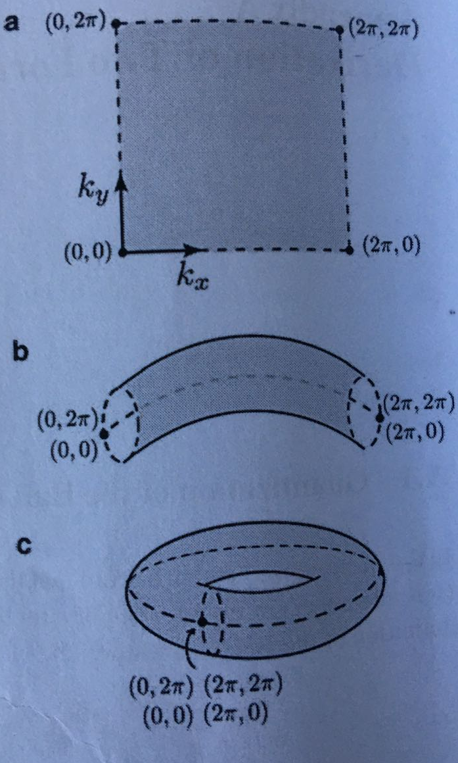
IQHE in graphene
Recalling that
|u(k_{x},2π)>=exp[iθ_{x}(k_{x})]|u(k_{x},0)>,
|u(2π,k_{y})>=exp[iθ_{x}(k_{x})]|u(0,2π)>:

Slide 32
IQHE in graphene

Slide 33
IQHE in graphene
Therefore, the Hall conductance must be quantized when the band is fully filled, This integer v is called Thouless-Kohmoto-Nightingale-Nijs(TKNN)number or the first Chern number,which is characterizes the topological structure of Bloch state |u(k_{x},k_{y})> in parameter space(k_{x},k_{y})

